Slide 1
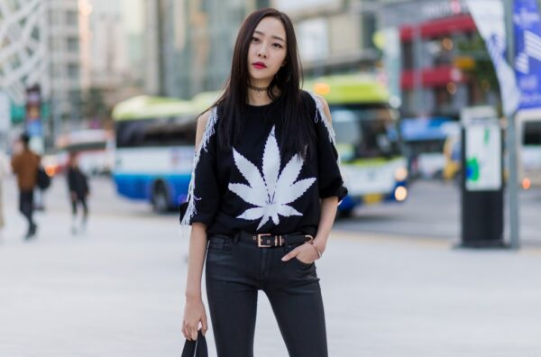
Addonis^{sm}
Powered by Pay420SM
Notes:
© Cannetics Global, Inc.

Slide 2
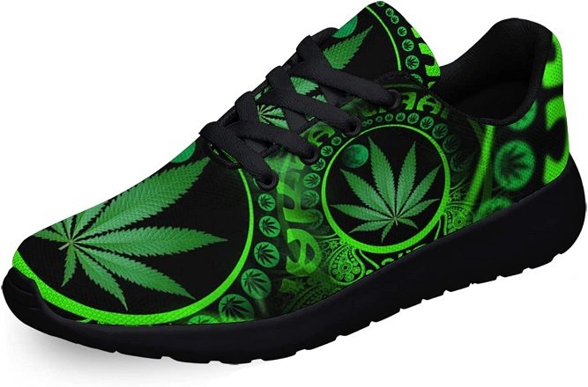
Problems we solve for Dispensaries:
Ability to sell non-canna merchandise (92% survey response)
(and avoid 280e tax on expense of product)
Brand is “very important to store income” (100%)
Direct digital connection to customers (100%)
Notes:
© Cannetics Global, Inc.

Slide 3
Vision
^{Your Dispensary}
Free to Dispensaries: an app with their brand on the customer-facing pages, commissions go to the dispensary.
Requirement for Membership: any purchase at a participating canna facility.
Choice of products for sale: determined by user data
The Fashionification of Weed has Begun
-- Harpers Bazaar
Notes:
© Cannetics Global, Inc.

Slide 4
Initial Product Spectrum:
INTEGRATED MOBILE APPLICATION
Canna accessories
-- Storz & Bickel
Canna apparel
-- BuddaLand
Jewelry
- TERY SABER JEWELRY
-- bein’me^{sm} Branded Canna Jewelry Collection
Potential integration of Retail Delivery
- InstaCart, Dell, Sketchers.
Example Product:
Notes:
© Cannetics Global, Inc.

Slide 5
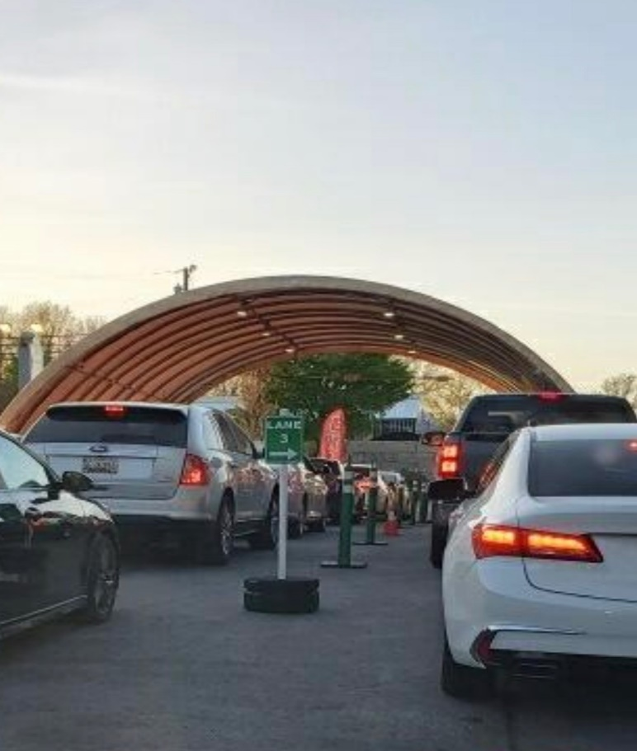
Valuation vs. Profit:
Huge cash investment
= High dispensary valuations
Many owners looking for profitability
Biggest asset:
HUGE, LOYAL, BUYER GROUP
Dispensary Line 4/20/2022, Urbana, MD
Courtesy Ana Palmisano
Notes:
© Cannetics Global, Inc.

Slide 6
Solution Edge (What Makes Us Special)
100% direct input from owners/operators
An entirely new (high) income source
Power of SMART PHONES
(Spontaneous, connected, secure)
“Mobile visitors … are now more than 50% of traffic.”
--MJBizDaily 12/17/2021
Notes:
© Cannetics Global, Inc.
https://www.microsoft.com/en-us/security/blog/2021/06/25/windows-11-enables-security-by-design-from-the-chip-to-the-cloud/

Slide 7
Product Specifics -- Jewelry:
“We did an extensive research on cannabis jewelry focusing on creativity, cost and material. We found that there is a huge gap in the affordable luxury market, which comprises around 35% of the jewelry sector. Retailing between $90-400.
Creativity of designs are also lacking. I think you have a big opportunity ahead if we focus on material and innovation.”
(Tery Saber Jewelry, Istanbul, Turkey)
Notes:
© Cannetics Global, Inc.

Slide 8
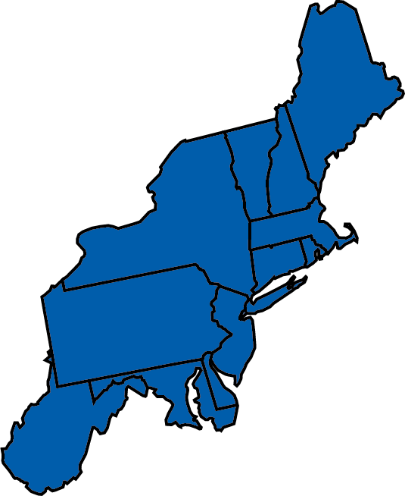
Market Size Growing – Current Demographics
“48.2 million people, or about 18% of Americans, used it at least once in 2019.” -- CDC
“In 2020, around 126.5 million people in the United States reported that they had used marijuana at least once in their lifetime.” -- Statista
6 of top 13 in the NE
Notes:
© Cannetics Global, Inc.

Slide 9
Target Market/ Timing
Northeastern states with EXISTING recreational legalization
ME, MA, CT, RI, VT
States with NEW Rec legalization
NY, NJ, MD (Est July 2023), PA (Est 2023)
Initial Saturation
33% of northeast dispensaries / year
Notes:
© Cannetics Global, Inc.

Slide 10
Marketing
Budget (Standard 10%)
$508,000 3-state trial / $2.3M rollout to northeast
Most effective distribution of funds
Gen Y, Gen X, Boomer II
High-end lifestyle magazines with QR Code
- Luxurious, Upscale Living , Vue
Digital Marketing – Google, Facebook
Canna Facilities – Dispensaries, CBD stores
Sign-up Events – Canna, jewelry, & apparel Conventions
Notes:
© Cannetics Global, Inc.

Slide 11
Competitors
Apparel orders through MSO’s
-- Terrascend/Apothecarium
Direct sales from manufacturers
Alpine IQ (partial) – offers a custom app
Notes:
© Cannetics Global, Inc.

Slide 12
Traction
Pay420SM trademark
– published 12/13/2022
CEO + connected sales-person engaged
Developing trial sales -- Addonis^{sm} online store.
Notes:
© Cannetics Global, Inc.

Slide 13
Execution & Repetition
Develop demo website $10,000
Review products $0
Initial product inventory $150,000
Trial application with 3 dispensaries $15,000
Trial marketing budget $508,000
Develop full application $67,000
Marketing operational app $1,500,000
Expanded U.S. target region(s) $2,250,000
--------------
Total: $4,500,000
Website trial sales
Application Dev
Trial Marketing Tri-state
MD, NJ, PA
Marketing Additional Region(s)
Notes:
© Cannetics Global, Inc.

Slide 14
Profit & Loss Projection
1st Partial Year Expense: $584,000
Income First Full Year: $0.679
Costs FFY: $1.4M
Profit: FFY: -$0.72M
Income Second Full Year: $16.5M
Costs SFY: $9.6M
Profit: $6.8M
*Included -- 3-year ramp-up to full dispensary income
Notes:
© Cannetics Global, Inc. 2023

Slide 15
Comparison Product Income
Not included: Sales tax & Shipping
Hoodie 4
 |  | Dispensary Member |  |  | Unaffiliated Buyer
 |  | $108.00 | 10% Disc |  | $120.00 | No Disc
 | Cost Each | ($60.00) |  |  | ($60.00)
 | Fulfill 5% | ($5.40) |  |  | ($6.00)
 | CC 3% | ($3.24) |  |  | ($3.60)
 | Site Fee 1% | ($1.08) |  |  | $0.00
 | Gross Profit | $38.28 |  |  | $50.40
 | Cut | 90/10 % |  |  | 10/90 %
 |  | Disp | CGI |  | Disp | CGI
 | Share Profit | $34.45 | $3.83 |  | $5.04 | $45.36
 | 2 Shirts | $39.49 |  |  |  | $49.19
 |  | 37% | 13% |  | 18% | 41%
Pay to Dispensary for Unaffiliated Buyer
(comm connected)
“Good online margins” 35-45%
Notes:
© Cannetics Global, Inc. 2023

Slide 16
Challenges
Reaching dispensary owners/operators
Conveying that the digital world is changing
Planning efficient pathways to development
Notes:
© Cannetics Global, Inc.

Slide 17
Exit Strategy
Canna culture market is changing so quickly, it is our estimate that any future buyer may not exist yet.
Options:
Acquisition by a jewelry company
Acquisition by an MSO
Pay-off the investment
Notes:
© Cannetics Global, Inc.

Slide 18
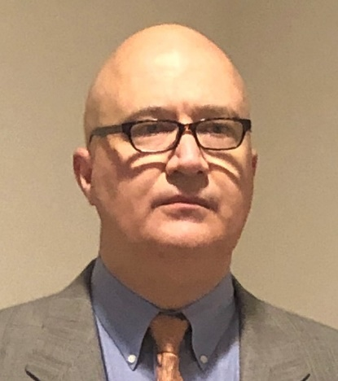
The Team
Steve Genung
CEO and Founder
Former Investment Advisor at Money Concepts International
Former healthcare company President
Food and Drug Administration (FDA) Office of International Relations, Director of Capacity Building
Former Instructor at The George Washington & Georgetown Universities, Washington, D.C.,
Matt Hersh
Cannabis Industry Advisor, Shareholder
Authored The Bud Tender’s Little Black Book
Former Vertical Manager, Ganja Goddess
Manager, Kip Dispensary, Maryland
Former General Manager, Ganjapreneur
Member Maryland Dispensary Association
Degree in International Business
“Exceptionally well organized” “…takes the initiative and delivers.” – Performance Report
Great understanding of strategic issues from a macro and micro perspective. Specifically, how industry changes impact incentives on an individual basis.
-- Garrett King, Housatonic Partners
He is one of the most brilliant, hardworking and innovative managers that I have worked with…. When challenges present themselves, Steve is creative with solutions backed up by evidence.
-- Dr. Sarah Bhatt
Notes:
© Cannetics Global, Inc.

Slide 19
Why Invest?
Emerging growth market
Highly profitable business model
Clear point of entry for near term revenue growth
Long-term revenue growth
Experienced core team
Notes:
© Cannetics Global, Inc.

Slide 20
Transaction
Company Status
Ask: $4.5M
Registered Delaware Corporation
Investment inst. available: SAFE Note
Current investment $18,000 USD.
Goal: secure $4.5M in funding
Shareholders Stephen Genung, Matt Hersh, Ana Palmisano.
Trademarks processing for Pay420^{Sm} , bein’me^{sm} and Addonis^{sm}
Online store in development
Steve Genung
Mobile (239) 989-8397
SGenung@CanneticsGlobal.com

